Slide 1
PRESENTATION ON: “SMART STREET LIGHT SYSTEM USING ARDUINO”

Slide 2
PROJECT MEMBER:
Mr.Ingawale Vijay Arun. (1712080156)
Mr.Joshi Avadhut Sunil. (1612080130)
Mr.Khandagale Pankaj Baban. (1712080158)
Mr.Nanaware Amol Dattatray (1412080067)

Slide 3
INDEX:
Sr No. | Title Name
1 | INTRODUCTION
2 | PROBLEM STATEMENT
3 | BLOCK DIAGRAM
4 | HARDWARE REQUIRMENT.
5 | SOFTWARE REQUIRMENT.
6 | METHODOLOGY
7 | CONCLUSION
8 | REFERENCE

Slide 4
INTRODUCTION
Automation systems are being preferred over the manual mode because it reduces the use of energy to saves energy. These automation systems play an essential role in making our daily life more comfortable and facilitate users from ceiling fans to washing machines and in other applications . Among all exciting applications.
Street lights play a vital role in our environment and also plays a critical role in providing light for safety during night-time travel. In this scenario, when the street lights are in working functionality over the whole night that consumes a lot of energy and reduces the lifetime of the electrical equipment such as electric bulb etc. Especially in cities’ streetlights, it is a severe power consuming factor and also the most significant energy expenses for a city. In this regard, an intelligent lighting control system can decrease street lighting costs up to 70% and increase the durability of the equipment.

Slide 5
PROBLEM STATEMENT:
To avoid the problems of street lights are ON incase of absence of vehicles and pedestrians and presence of sunlight.

Slide 6
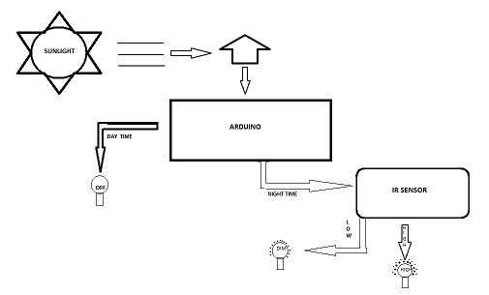
BLOCK DIAGRAM:

Slide 7
HRADWARE REQUIRMENT:
1.LDR.
2.Arduino Uno.
3.LEDs.
4. IR sensor.
5.Resistors.

Slide 8
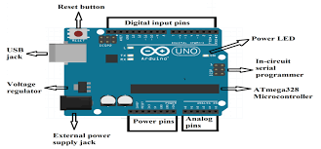
1.Arduino Uno.
* Arduino is single board m/c intended to make the appln of intractive objectibe or environment more accessible.
* The hardware consist of an open source h/w board designed around an 8 bit Atmel AVR m/c.

Slide 9
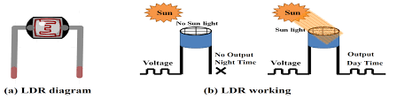
2.LDR.
LDR is a Light Dependent Resistor whose resistance is dependent on the light impinging on it. The resistance offered by the sensor decreases with the increase in light strength and increases with the decrease in light strength.
This device is used for detection of day-time and night-time because when sunlight falls on it, it will consider as day-time, and when there is no sunlight falls on it, it will be regarded as a night, as shown in Fig. 2b. These are very beneficial, especially in light/dark sensor circuits and help in automatically switching ON /OFF the street lights.

Slide 10
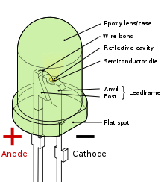
3.LEDs.
A LED (light-emitting diode) is a PN junction diode which is used for emitting visible light when it is activated, as presented in Fig.
When the voltage is applied over its elements, electrons regroup with holes within the LED, releasing energy in the form of photons which gives the visible light. LEDs may have the Dim/full capability.

Slide 11
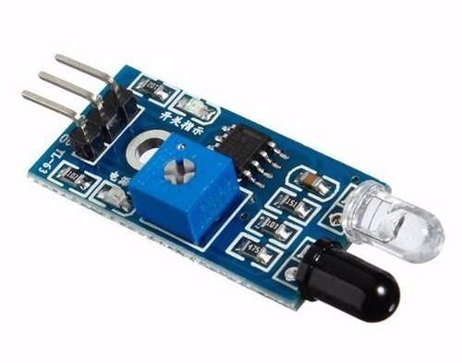
4. IR sensor.
An obstacle avoidance sensor consists of an infrared-transmitter, an infrared-receiver and a potentiometer for adjusting the distance, shown in Fig.
Whenever an object passes in front of a sensor, the emitted rays hit the surface of an object and reflect to the receiver of the sensor so it will consider this as a motion as shown in Fig. It is a heat sensitive sensor and used for detection of motion.

Slide 12
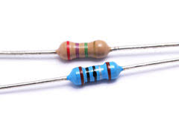
5.Resistors.
A resistor is a passive electronic component, used with other electronic components such as LEDs and sensors to prevent or limit the flow of electrons through them as illustrated in Fig. 6. It works on the principle of Ohm’s law which prevent overflow of voltage.

Slide 13
SOFTWARE REQUIRMENT:
1.Arduino IDE.

Slide 14
METHODOLOGY
In the beginning, the LDR sensor will sense the light intensity in the atmosphere at that time and consequently sends the data to Arduino. After receiving the data, Arduino will convert it into different discrete values from 0 to 1023 (In which 0 represents maximum darkness and 1023 represents maximum brightness) and then it will adjust the output voltage accordingly from 0 to 2.5v/5v (Dim/High) depending upon the received value (0-2023) by comparing with threshold value. So, the output will be 2.5v in the complete darkness (night time) if the received value is less than the threshold value. As a result, Dim LEDs will glow that is the half of maximum brightness, and when there is completely shine (daytime), the received value will be higher than the threshold value, and the output voltage would be 0v resulting the LEDs to be entirely switched OFF.

Slide 15
Initially, the IR obstacle detection sensor will be HIGH. So, when there is no vehicle/obstacle in-front of the sensor, IR Transmitter does continuously transmit the IR light. Whenever, a car or any other object blocks any of the IR sensors, then the emitted rays will reflect the IR receiver after hitting the object, then microcontroller will sense it as a motion. In simple words, when any object passed in front of the first IR sensor, the corresponding LEDs will be turned from DIM to HIGH (5v) by the microcontroller.
As the object moves forward and blocks the next IR sensor, the next three LEDs will be turned to HIGH from DIM, and the LEDs from the previous set is switched to DIM from HIGH. The process continues this way for the entire IR obstacle detector sensors and LEDs. These kinds of application can be implemented in the headlights of vehicles, street lights, parking lights of hotels, malls and homes, and it can be very beneficia.

Slide 16
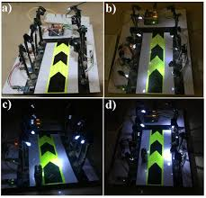
As an example, , the first set of LEDs are glowing HIGH and remaining are in DIM mode because the sensed intensity value of sunlight by LDR is below then the threshold value so, it considered nighttime and, there is an object detected by the first IR sensor. Moreover, when the object moved to the second IR obstacle detector sensor, the second set of High LEDs are glowing and the first set again turns to DIM state.

Slide 17
CONCLUSION:
The proposed streetlight automation system is a cost effective and the safest way to reduce power consumption. It helps us to get rid of today's world problems of manual switching and most importantly, primary cost and maintenance can be decreased easily. The LED consumes less energy with cool-white light emission and has a better life than high energy consuming lamps.
Moving to the new & renewable energy sources, this system can be upgraded by replacing conventional LED modules with the solar-based LED modules. With these efficient reasons, this presented work has more advantages which can overcome the present limitations. Keep in mind that these long-term benefits; the starting cost would never be a problem because the return time of investment is very less.

Slide 18
REFERENCE:
[1] www.youtube.com .
[2] www.electronicshub.org .
[3] www.wikipideia.com.

Slide 19
thank you…….

